Slide 1

Web Service and Database Handling part 4 Editing and Adding Child data
Emerging Technology : Flutter
Week 11
Program Studi Teknik Informatika
Fakultas Teknik – Universitas Surabaya

Slide 2

EDITING FORM
01

Slide 3

Before Continue
factory PopMovie.fromJson(Map<String, dynamic> json) {
return PopMovie(
id: json['movie_id'] as int,
title: json['title'] as String,
overview: json['overview'] as String,
voteAverage: json['voteAverage'] != null
? json['voteAverage'].toString()
: '0.0',
homepage: json['homepage'].toString(),
release_date: json['release_date'].toString(),
runtime: json['runtime'].toString(),
url: json['url'].toString(),
genres: json['genres']);
}
}
class PopMovie {
int id;
String title;
String overview;
String voteAverage;
String homepage;
String release_date;
String runtime;
String url;
List? genres;
PopMovie(
{required this.id,
required this.title,
required this.overview,
required this.voteAverage,
required this.homepage,
required this.release_date,
required this.runtime,
required this.url,
this.genres});
Update your PopMovie class. Because we need to access the homepage, release_date, runtime, and url column in database

Slide 4
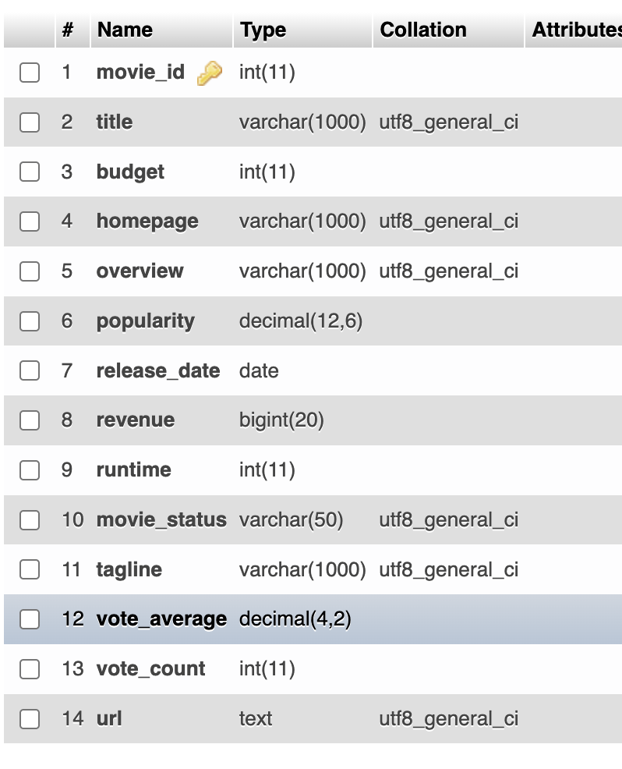
Before Continue
class PopMovie {
int id;
String title;
String overview;
String voteAverage;
String homepage;
String release_date;
String runtime;
String url;
List? genres;
PopMovie(
{required this.id,
required this.title,
required this.overview,
required this.voteAverage,
required this.homepage,
required this.release_date,
required this.runtime,
required this.url,
this.genres});
Since the original movie table doesn't have “url” column, you need to add it manually

Slide 5
Page preparation
Prepare a page for editing. It can be similar with our previous submission form, but with all field already filled in.
It is called with a parameter, similar with detail movie page. The parameter is movie_id. This page will be called from 2 places:
- In the detail movie page
- Right after save new movie.
We name it editpopmovie.dart, using stateful skeleton.

Slide 6
editpopmovie.dart
class EditPopMovieState extends State<EditPopMovie> {
final _formKey = GlobalKey<FormState>();
@override
Widget build(BuildContext context) {
return Scaffold(
appBar: AppBar(
title: Text("Edit Popular Movie"),
),
body: Form(
key: _formKey,
child: Column(
children: <Widget>[Text(widget.movieID.toString())],
),
));
}
}
  class EditPopMovie extends StatefulWidget {
  int movieID;
  EditPopMovie({super.key, required this.movieID});
  @override
  EditPopMovieState createState() {
  return EditPopMovieState();
  }
  }

Slide 7
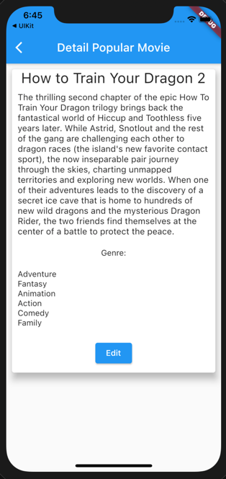
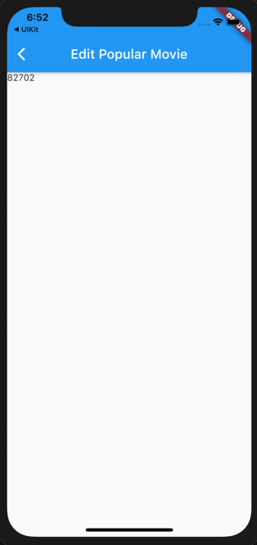
Update detailpop
Padding(
padding: EdgeInsets.all(10),
child: ElevatedButton(
child: Text('Edit'),
onPressed: () {
Navigator.push(
context,
MaterialPageRoute(
builder: (context) =>
EditPopMovie(movieID: widget.movieID),
),
);
},
)),

Slide 8
Fetch Data
Prepare a variable for storing popmovie and fill it with a fetching data function
PopMovie? _pm;
Future<String> fetchData() async {
final response = await http.post(
Uri.parse("https://ubaya.cloud/flutter/[NRP]/detailmovie.php"),
body: {'id': widget.movieID.toString()});
if (response.statusCode == 200) {
return response.body;
} else {
throw Exception('Failed to read API');
}
}
  bacaData() {
  fetchData().then((value) {
  Map json = jsonDecode(value);
  _pm = PopMovie.fromJson(json['data']);
  setState(() {});
  });
  }

Slide 9
Edit Title
For initiate value in a XXXFormField , we need a controller to be attached on it.
TextEditingController _titleCont = TextEditingController();
Update bacaData, fill text attribut of the controller. call bacaData in initState
setState(() {
_titleCont.text = _pm!.title; });
@override
void initState() {
// TODO: implement initState
super.initState();
bacaData();
}

Slide 10
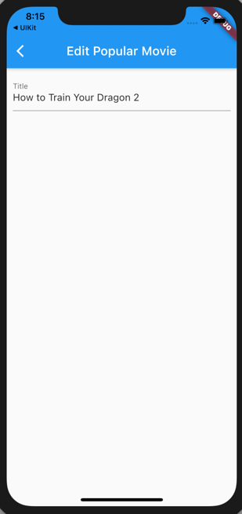
Edit Title (2)
TextFormField:
Padding(
padding: EdgeInsets.all(10),
child: TextFormField(
decoration: const InputDecoration(
labelText: 'Title',
),
onChanged: (value) {
_pm!.title = value;
},
controller: _titleCont,
validator: (value) {
if (value == null || value.isEmpty) {
return 'judul harus diisi';
}
return null;
},
)),

Slide 11
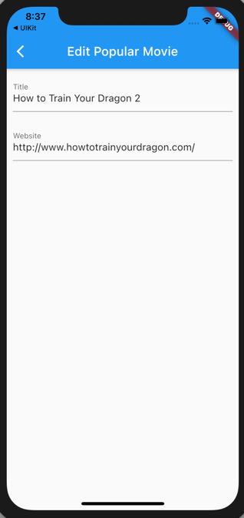
Edit Homepage
Edit your PopMovie class as needed
TextFormField:
Prepare the controller
Padding(
padding: EdgeInsets.all(10),
child: TextFormField(
decoration: const InputDecoration(
labelText: 'Website',
),
onChanged: (value) {
_pm!.homepage = value;
},
controller: _homepageCont,
validator: (value) {
if (value == null || !Uri.parse(value).isAbsolute) {
return 'alamat website salah';
}
return null;
},
)),
TextEditingController _homepageCont= TextEditingController();
Update bacaData
setState(() {
_titleCont.text = _pm!.title;
_homepageCont.text = _pm!.homepage;
});

Slide 12
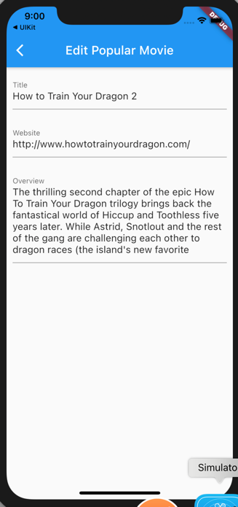
Edit Overview
Prepare the controller
TextEditingController _overviewCont = TextEditingController();
TextFormField:
Update bacaData
Padding(
padding: EdgeInsets.all(10),
child: TextFormField(
decoration: const InputDecoration(
labelText: 'Overview',
),
onChanged: (value) {
_pm!.overview = value;
},
controller: _overviewCont,
keyboardType: TextInputType.multiline,
minLines: 3,
maxLines: 6,
)),
setState(() {
_titleCont.text = _pm!.title;
_homepageCont.text = _pm!.homepage;
_overviewCont.text = _pm!.overview;
});

Slide 13
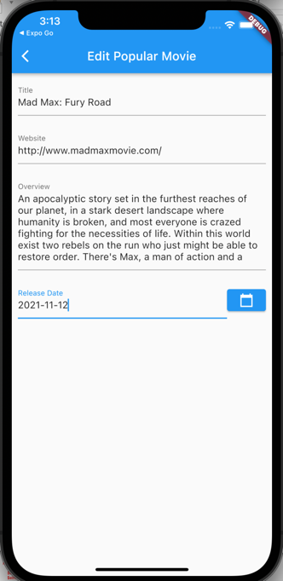
Update ReleaseDate
TextFormField:
Prepare the controller
Padding(
padding: EdgeInsets.all(10),
child: Row(
mainAxisAlignment: MainAxisAlignment.start,
children: [
Expanded(
child: TextFormField(
decoration: const InputDecoration(
labelText: 'Release Date',
),
controller: _releaseDate,
)),
ElevatedButton(
onPressed: () {
showDatePicker(
context: context,
initialDate: DateTime.now(),
firstDate: DateTime(2000),
lastDate: DateTime(2200))
.then((value) {
setState(() {
_releaseDate.text =
value.toString().substring(0, 10);
});
});
},
child: Icon(
Icons.calendar_today_sharp,
color: Colors.white,
size: 24.0,
))
],
)),
TextEditingController _releaseDate
= TextEditingController();
Update bacaData
setState(() {
_titleCont.text = _pm!.title;
_homepageCont.text = _pm!.homepage;
_overviewCont.text = _pm!.overview;
_releaseDate.text = _pm!.release_date;
});
Edit your PopMovie class as needed

Slide 14
Update Runtime
TextFormField :
Prepare variable
Padding(
padding: EdgeInsets.all(10),
child: TextFormField(
inputFormatters: <TextInputFormatter>[
FilteringTextInputFormatter.digitsOnly
],
decoration: const InputDecoration(
labelText: 'Runtime',
),
controller: _runtimeCont,
validator: (value) {
if (value == null || value.isEmpty) {
return 'Runtime harus diisi';
}
return null;
},
)),
TextEditingController _runtimeCont = TextEditingController();
Update bacaData
setState(() {
_titleCont.text = _pm!.title;
_homepageCont.text = _pm!.homepage;
_overviewCont.text = _pm!.overview;
_releaseDate.text = _pm!.release_date;
_runtimeCont.text = _pm!.runtime;
});

Slide 15
Update URL
TextFormField :
Prepare variable
Padding(
padding: EdgeInsets.all(10),
child: TextFormField(
decoration: const InputDecoration(
labelText: 'URL Poster',
),
onChanged: (value) {
validateImage(value).then((v) {
setState(() {
});
}
);
},
controller: _urlCont,
validator: (value) {
if (value == null || !Uri.parse(value).isAbsolute) {
return 'alamat url salah';
}
return null;
},
)),
if(_urlCont.text!='') Image.network(_urlCont.text),
TextEditingController _urlCont = TextEditingController();
Update bacaData
setState(() {
_titleCont.text = _pm!.title;
_homepageCont.text = _pm!.homepage;
_overviewCont.text = _pm!.overview;
_releaseDate.text = _pm!.release_date;
_runtimeCont.text = _pm!.runtime;
_urlCont.text=_pm!.url;
});
You can copy paste validateImage method from newpopmovie.dart

Slide 16
The Web service
updatemovie.php
extract($_POST);
$sql="UPDATE movie set title=? , overview=?, runtime=?,release_date=?,homepage=?, url=? where movie_id=?";
$stmt=$conn->prepare($sql);
$stmt->bind_param("ssisssi",$title,$overview,$runtime,$release_date,$homepage,$url,$movie_id);
$stmt->execute();
if ($stmt->affected_rows > 0) {
$arr=["result"=>"success"];
} else {
$arr=["result"=>"fail","Error"=>$conn->error];
}
echo json_encode($arr);

Slide 17
Submit
Prepare the async function.. And the button
void submit() async {
final response = await http.post(
Uri.parse("https://ubaya.cloud/flutter/[NRP]/updatemovie.php"),
body: {
'title': _pm!.title,
'overview': _pm!.overview,
'homepage': _pm!.homepage,
'release_date':_pm!.release_date,
'runtime':_pm!.runtime.toString(),
'url':_urlCont.text,
'movie_id': widget.movieID.toString()
});
if (response.statusCode == 200) {
Map json = jsonDecode(response.body);
if (json['result'] == 'success') {
if (!mounted) return;
ScaffoldMessenger.of(context)
.showSnackBar(SnackBar(content: Text('Sukses mengubah Data')));
}
} else {
throw Exception('Failed to read API');
}
}
  Padding(
  padding: const EdgeInsets.symmetric(vertical: 16.0),
  child: ElevatedButton(
  onPressed: () {
  var state = _formKey.currentState;
  if (state == null || !state.validate()) {
  ScaffoldMessenger.of(context).showSnackBar(
  SnackBar(content: Text('Harap Isian diperbaiki')));
  } else {
  submit();
  }
  },
  child: Text('Submit'),
  ),
  ),

Slide 18
ADD CHILD DATA
02

Slide 19
Child data
After editing the movie data, we will continue to store the children data of the movie. We will add the genres in our editing form.
We will add a combobox that is filled with the genre names. When user chooses one of genre in the combo box, our movie will be added with that genre.

Slide 20
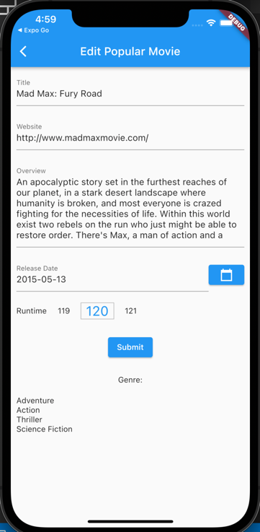
Add the genre info
Taken from our detailpop
Padding(padding: EdgeInsets.all(10), child: Text('Genre:')),
if(_pm != null)
Padding(
padding: EdgeInsets.all(10),
child: ListView.builder(
shrinkWrap: true,
itemCount: _pm!.genres!.length ?? 0,
itemBuilder: (BuildContext ctxt, int index) {
return Text(_pm!.genres![index]['genre_name']);
})),

Slide 21
Web Service genrelist.php
We will just shows genres that not already listed in the movie. Therefore the webservice genrelist will need movie_id parameter
$sql = "SELECT *,genre_name as label,genre_id as value
FROM genre WHERE genre_id NOT IN
(SELECT genre_id FROM movie_genres WHERE movie_id=?)";
$stmt = $conn->prepare($sql);
$stmt->bind_param("i", $_POST['movie_id']);
$stmt->execute();
$result = $stmt->get_result();
$data = [];
if ($result) {
while ($r = $result->fetch_assoc()) {
array_push($data, $r);
}
$arr = ["result" => "success", "data" => $data];
} else {
$arr = ["result" => "error", "message" => "sql error: $sql"];
}
echo json_encode($arr);

Slide 22
Combo genre
We prepare the class for the genrelist output. genre.dart
class Genre {
int genre_id;
String genre_name;
Genre({required this.genre_id, required this.genre_name});
factory Genre.fromJSON(Map<String, dynamic> json) {
return Genre(
genre_id: json["value"],
genre_name: json["label"],
);
}
}

Slide 23
Combo genre (2)
Prepare the web service fetcher
Future<List> daftarGenre() async {
Map json;
final response = await http.post(
Uri.parse("https://ubaya.cloud/flutter/[NRP]/genrelist.php"),
body: {'movie_id': widget.movieID.toString()});
if (response.statusCode == 200) {
print(response.body);
json = jsonDecode(response.body);
return json['data'];
} else {
throw Exception('Failed to read API');
}
}

Slide 24
About DropdownButton
About the DropDownButton,
the simple structure without
generating the items from list of map:
In our case, items will be generated from List of map of genres to become List of DropdownMenuItem
DropdownButton(
value: _value,
items: [
DropdownMenuItem(
child: Text("First Item"),
value: 1,
),
DropdownMenuItem(
child: Text("Second Item"),
value: 2,
),
DropdownMenuItem(
child: Text("Third Item"),
value: 3
) ],
onChanged: (value) {
setState(() {
_value = value;
});
}
),

Slide 25
Combo genre (3)
void generateComboGenre() {
List<Genre> genres;
var data = daftarGenre();
data.then((value) {
genres = List<Genre>.from(value.map((i) {
return Genre.fromJSON(i);}));
setState(() {
comboGenre = DropdownButton(
dropdownColor: Colors.grey[100],
hint: const Text("tambah genre"),
isDense: false,
items: genres.map((gen) {
return DropdownMenuItem(
value: gen.genre_id,
child: Column(children: <Widget>[
Text(gen.genre_name, overflow: TextOverflow.visible),
]),
);
}).toList(),
onChanged: (value) {});
});
});
}
Prepare the combo item lists and the widget
Widget comboGenre = Text('tambah genre');

Slide 26
Combo genre (3)
Call the generateComboGenre() inside bacaData()
bacaData() {
fetchData().then((value) {
Map json = jsonDecode(value);
_pm = PopMovie.fromJson(json['data']);
generateComboGenre();
setState(() {
_titleCont.text = _pm!.title;
_homepageCont.text = _pm!.homepage;
_overviewCont.text = _pm!.overview;
_releaseDate.text = _pm!.release_date;
_runtimeCont.text = _pm!.runtime;
_urlCont.text = _pm!.url;
});
});
}

Slide 27
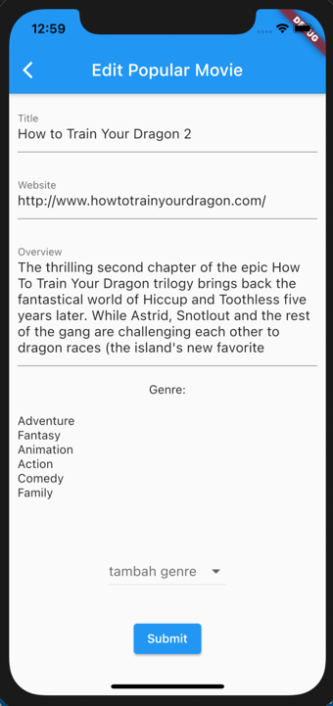
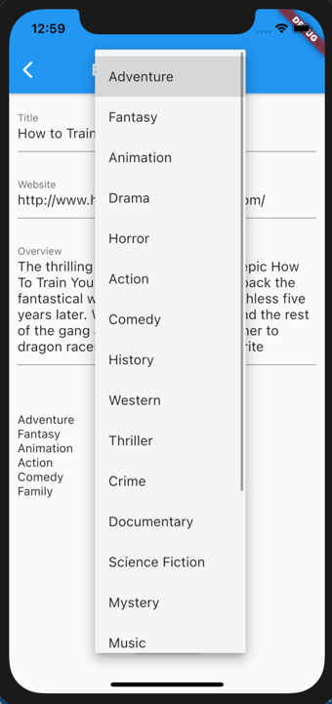
Combo genre (4)
Call generateComboGenre() in bacaData
Add the combo below genre list
Padding(
padding: const EdgeInsets.symmetric(vertical: 16.0),
child: comboGenre),

Slide 28
Prepare addmoviegenre web service
…..
extract($_POST);
$sql="INSERT INTO movie_genres(movie_id,genre_id)
VALUES(?,?)";
$stmt=$conn->prepare($sql);
$stmt->bind_param("dd",$movie_id,$genre_id);
$stmt->execute();
if ($stmt->affected_rows > 0) {
$arr=["result"=>"success","id"=>$conn->insert_id];
} else {
$arr=["result"=>"fail","Error"=>$conn->error];
}
echo json_encode($arr);

Slide 29
Save movie genre and reread data
Calling web service. in onChange
(generateComboGenre):
void addGenre(genre_id) async {
final response = await http.post(
Uri.parse("https://ubaya.cloud/flutter/[NRP]/addmoviegenre.php"),
body: {'genre_id': genre_id.toString(), 'movie_id': widget.movieID.toString()
});
if (response.statusCode == 200) {
print(response.body);
Map json = jsonDecode(response.body);
if (json['result'] == 'success') {
ScaffoldMessenger.of(context)
.showSnackBar(SnackBar(content: Text('Sukses menambah genre')));
setState(() {
bacaData();
});
}
} else {
throw Exception('Failed to read API');
}
}
onChanged: (value) {
addGenre(value);
});

Slide 30
EXERCISE
03

Slide 31
Exercise
Create webservice to delete a certain genre in the movie (parameter: movie_id and genre_id).
Add an X button in each genre in the movie. When user click the button call above web service and re read the data.
Upload your lib folder to ULS

Slide 32



